Slide 1
Ames Housing Prices
Project 2, Group 1

Slide 2
Problem Statement
To predict housing prices in Ames, Iowa to help in decision-making for:
Policy-makers to better regulate housing prices
Developers to know how and where to build.
Description of the data - 80 variables; categorical, numerical, ordinal
Overall quality
Square feet of houses

Slide 3
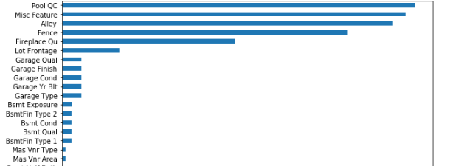
Data Cleaning
Issue: Many missing values across variables

Slide 4
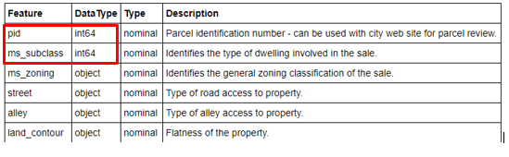
Data Cleaning
Issue: Variables with wrong data type

Slide 5
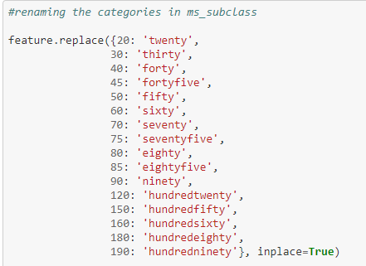
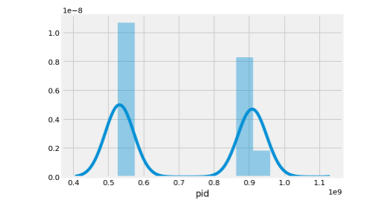
Data Cleaning
Issue: Variables with wrong data type
pid
ms_subclass

Slide 6
Data Cleaning
Issue: Impossible values e.g. garage was built in year 2207
Choice of Imputation becomes critical

Slide 7
Imputations
How we filled in missing values:
Categorical Variables
Continuous Variables
Assumptions

Slide 8
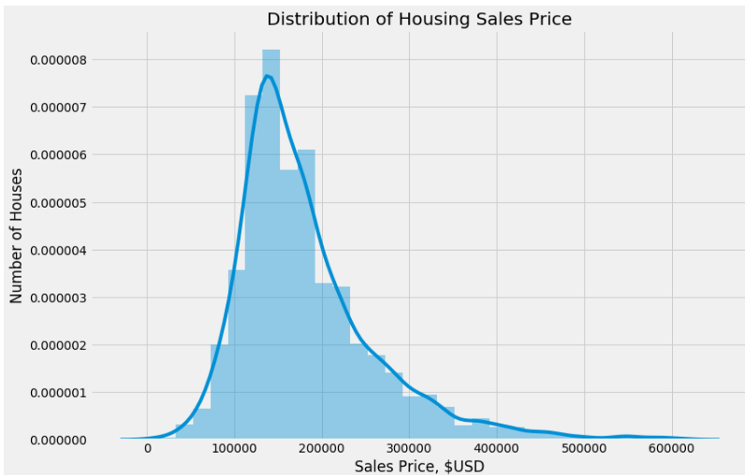
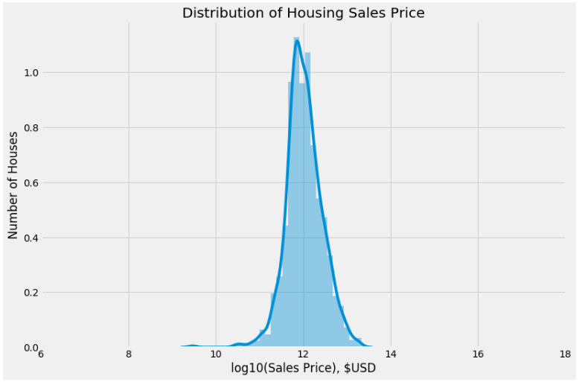
Feature Selection

Slide 9
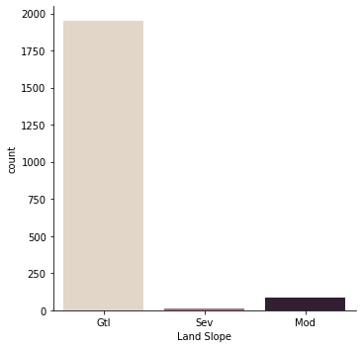
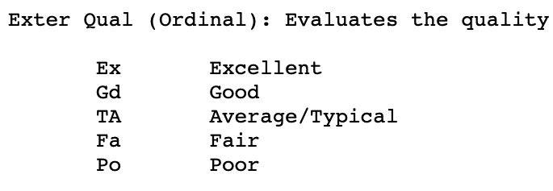
Feature Selection
Categorical Variables
Ordinal Variables
5
4
3
2
1

Slide 10
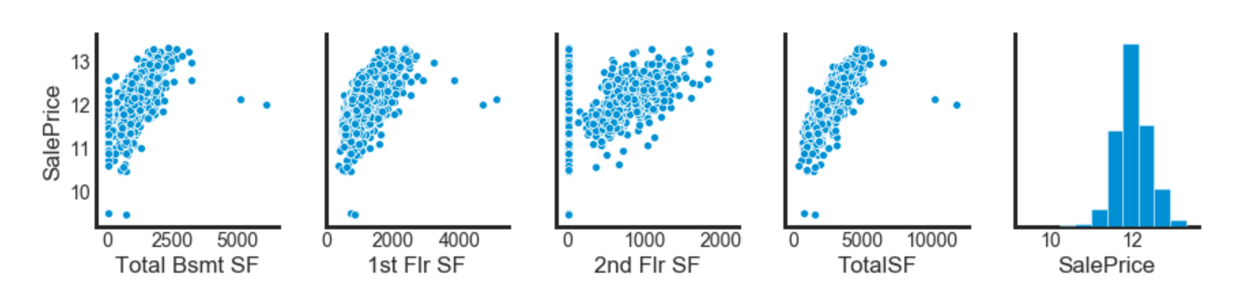
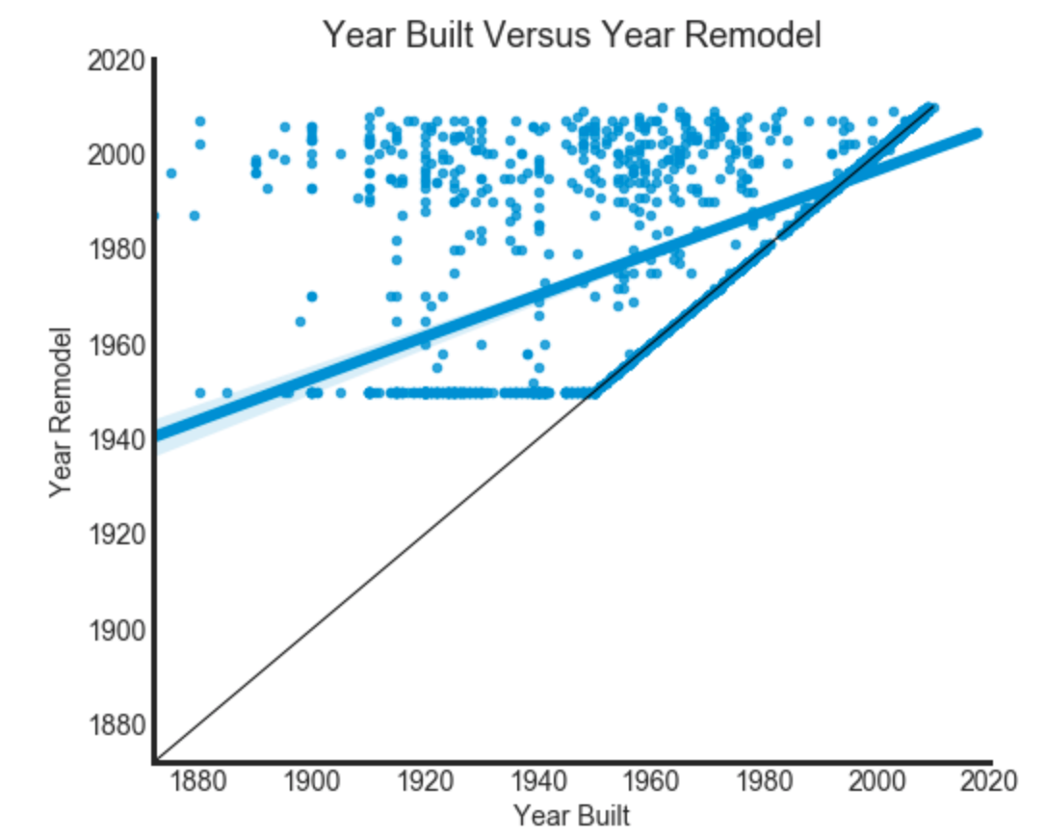
Feature Selection
Combination:
i) Total SF = Total Bsmt SF + 1st Flr SF + 2nd Flr SF
Apply the same for:
Total Full Bathroom = Full Bath + Bsmt Full Bath
Total Half Bathroom = Half Bath + Half Bathroom
ii) Remodel =
1 (if yes)
0 (if no)

Slide 11
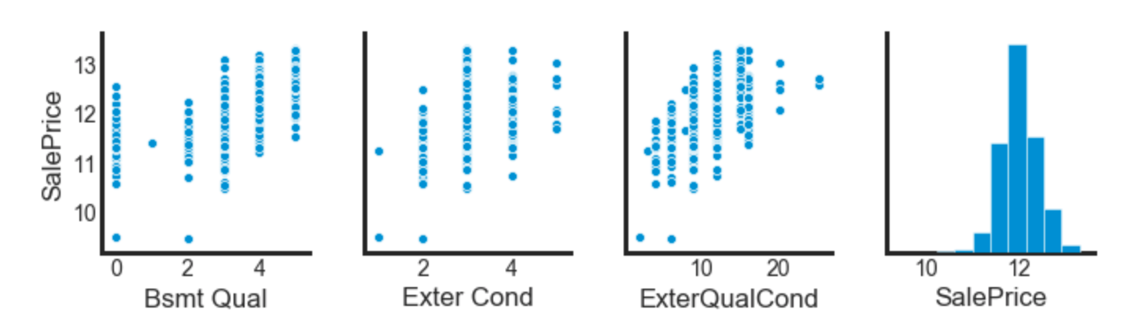
Feature Selection
b. Interaction:
i) Interaction [External Quality Condition ] = External Quality * External Condition
Apply the same for: Basement Quality * Basement Condition, Garage Quality * Garage Condition

Slide 12

Model of Choice
Regression Model:
Linear Regression, Ridge, Lasso
Use cross_val_score to evaluate all the three models
Models chosen: Lasso
Reason: Lasso is able to do feature selection by zeroing out the insignificant features
Performance measure: R-square
It determines how much of the total variation in Y (dependent variable) is explained by the variation in X (independent variable).
R-square : 89% (test set), 91% (train set)

Slide 13
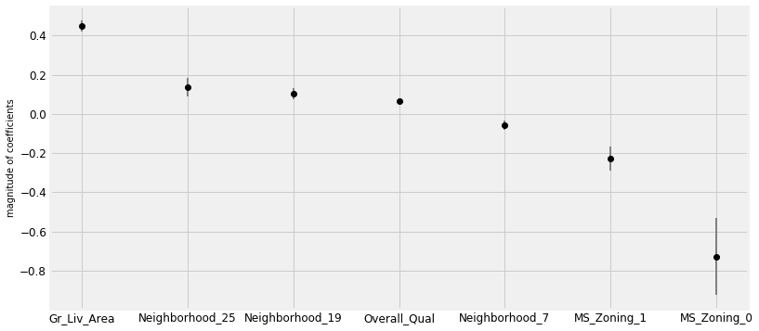
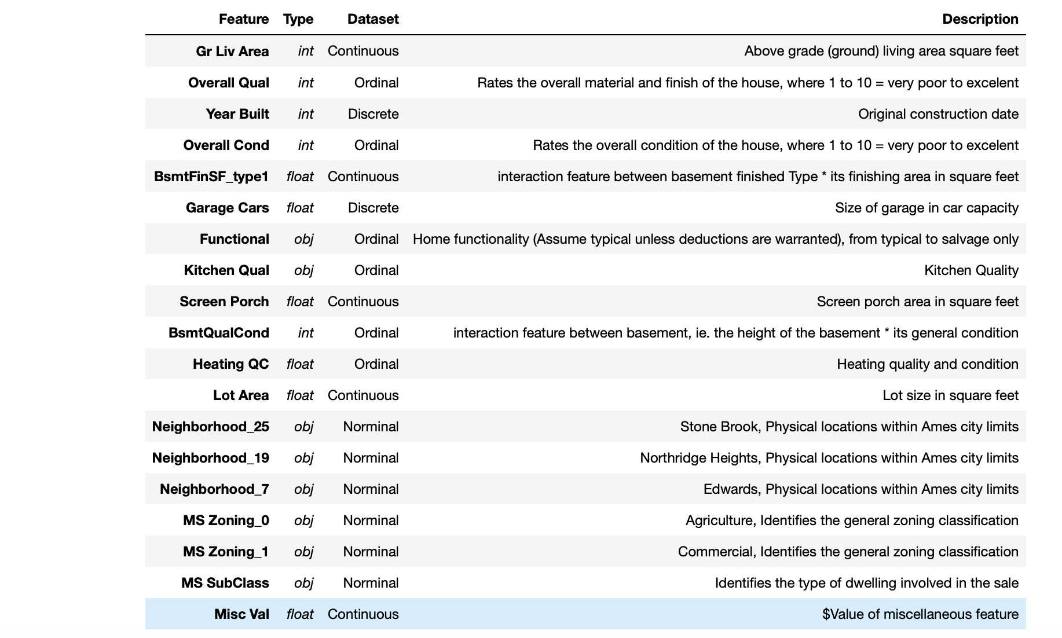
Conclusion & Recommendation
1
2
2
3
3
Developers are encouraged to build housing with larger living room.
Certain Neighbourhoods (North-ridge Height,Somerset) seems to be popular
Avoid developing in agricultural/commercial area

Slide 14
Improvements
More Data
Crime-rate in the region
Buyer info
Considerations on business standpoint
Sale-price or Sale-price per sq feet
Note: Will not generalise well to other cities

